Slide 1
INFO 323:Cloud Computing and Big Data
College of Computing and Informatics
Drexel University
Lecture for Week 2-2
Ingest Data into Cloud
Yuan An, PhD
Associate Professor

Slide 2
Make Probabilistic Decision
You are about to take a flight and, just before the flight takes off from the runway (and you are asked to switch off your phone), you have the opportunity to send one last text message.
It is past the published departure time and you are a bit anxious.
You have scheduled an important meeting with a client at its offices.
You need to decide whether to cancel the meeting or not.

Slide 3
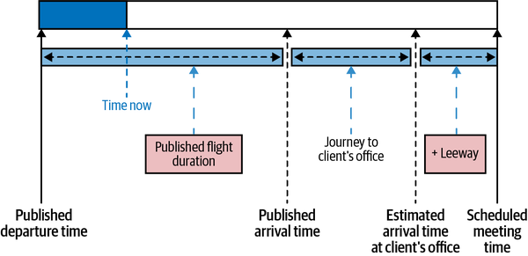
Cancel or not cancel

Slide 4
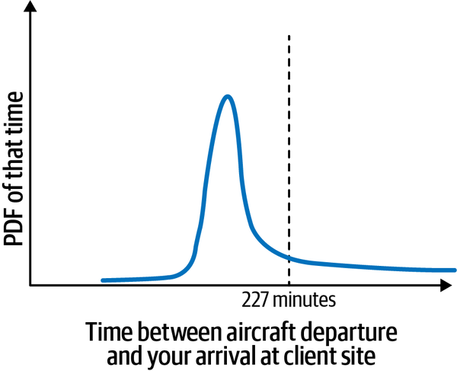
Probability Density Function (PDF)

Slide 5
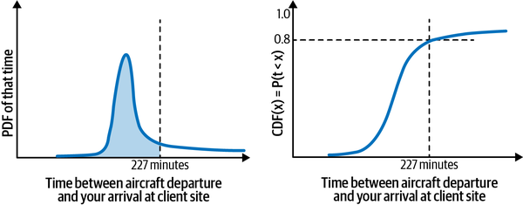
Cumulative Distribution Function (CDF)

Slide 6
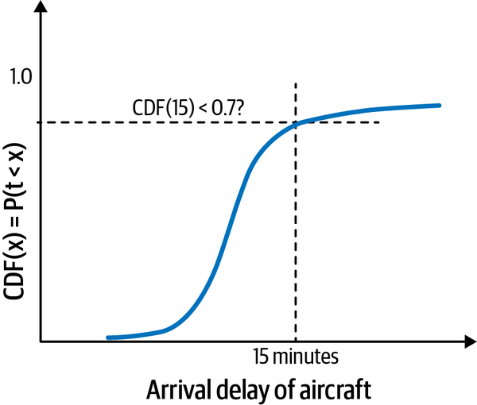
Cancel the meeting if chance of arrival delay greater than 15min is more than 30%.

Slide 7
On-time Performance Data of Flights
Go to: https://transtats.bts.gov/
Search this site: performance
Click the link: Airline On-Time Performance Data
Click the link: Reporting Carrier On-Time Performance (1987-present)

Slide 8
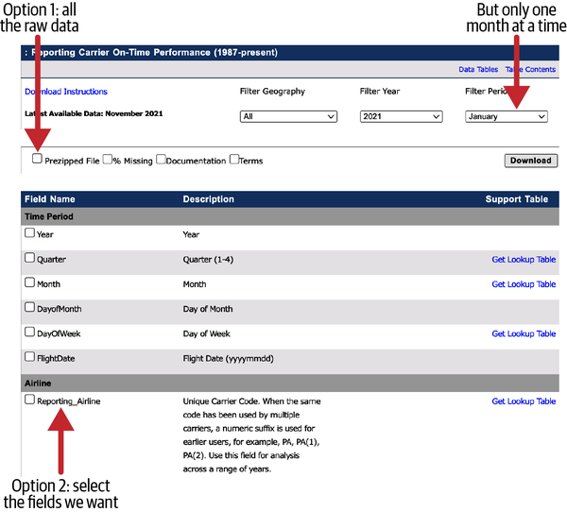
Download the Data

Slide 9
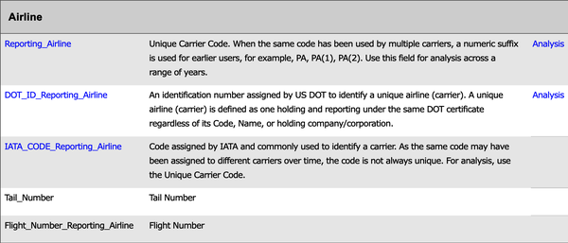
Dataset Fields
Read through the column descriptions provided by BTS to learn more about the dataset and get a preliminary idea about what fields are relevant to our problem and whether there are any caveats.

Slide 10
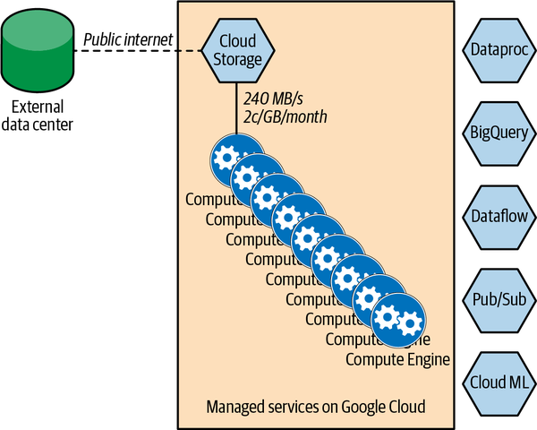
Separation of Compute and Storage

Slide 11
Web Scraping BTS
BTS=https://transtats.bts.gov/PREZIP
BASEURL="${BTS}/On_Time_Reporting_Carrier_On_Time_Performance_1987_present"
YEAR=2015
MONTH=3
curl -k -o temp.zip ${BASEURL}_${YEAR}_${MONTH}.zip

Slide 12
Download the monthly data
for MONTH in `seq 1 12`; do
bash download.sh $YEAR $MONTH
done

Slide 13
Explore the data
head -2 201503.csv
head -2 201503.csv | tail -1 | sed 's/,/ /g' | wc –w
wc -l *.csv

Slide 14
Upload the Data to Cloud Storage
gsutil -m cp *.csv gs://cloud-training-demos-ml/flights/raw/
Wc –l file
Gsutil cp 2015_3.csv 2015_4.csv gs://…

Slide 15
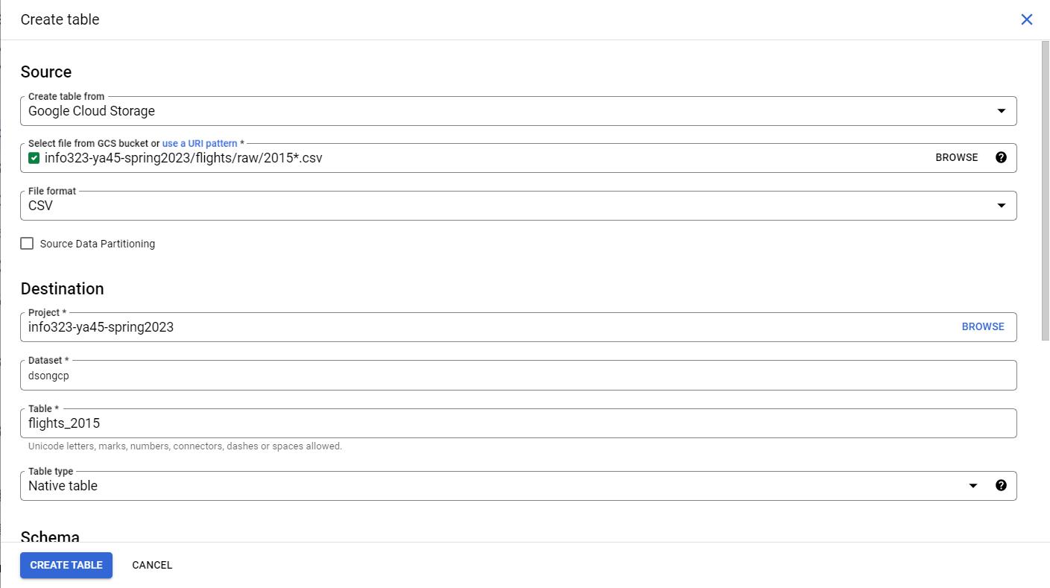
Ingest Data into BigQuery

Slide 16
Query the Data Table
SELECT
ORIGIN,
AVG(DEP_DELAY) AS dep_delay,
AVG(ARR_DELAY) AS arr_delay,
COUNT(ARR_DELAY) AS num_flights
FROM
dsongcp.flights_auto
GROUP BY
ORIGIN
ORDER BY num_flights DESC
LIMIT 10 (5)

